Slide 1



Credit Analyzer
For

Slide 2

ABOUT US
SkyBits Technologies, Is an Artificial Intelligence software development firm providing solutions and products to various global clients. It was founded by the veterans of the IT industry with immense global experience. The core focus areas for SkyBits are Image Processing and Natural Language Processing (NLP) based on strong foundations in Deep Learning technologies.

Slide 3

Credit Analyzer
Sky Credit Analyzer is an
AI based Solution that will

Slide 4
Features

Slide 5



Annual Report Analyzer
Company Annual Report
Natural Language Processing
Text Classification
Highlights important aspect of the report that have future and present implication

Slide 6
Approach In-Depth

Slide 7
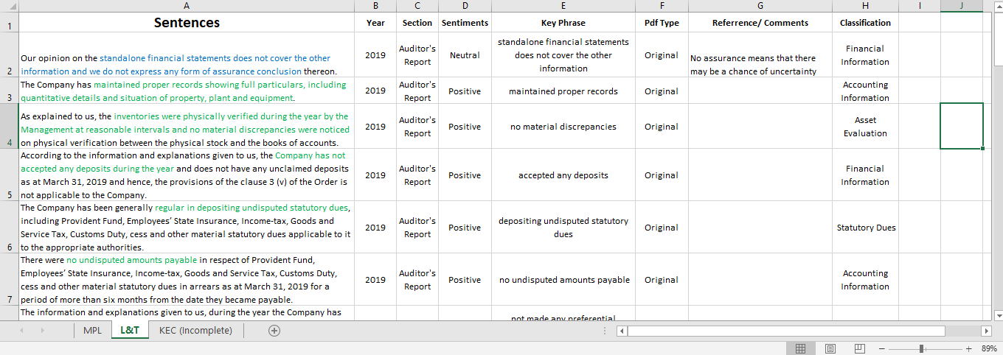
Sample Training Data

Slide 8






OUR CLIENTS

Slide 9
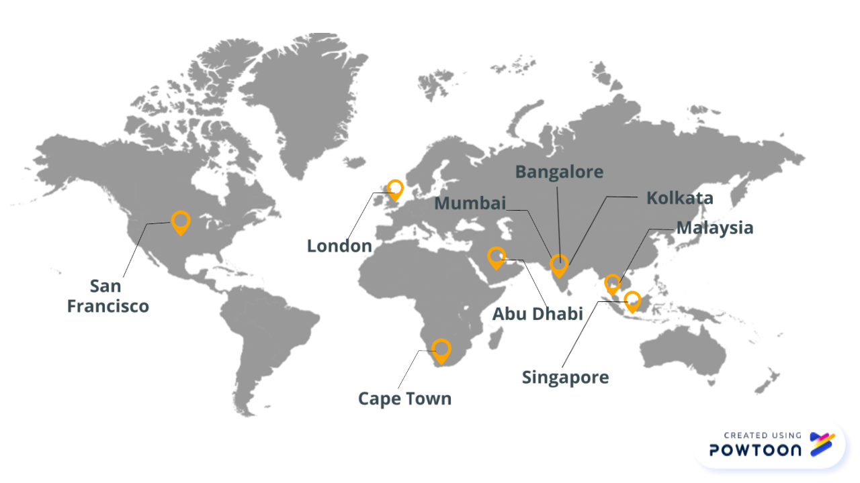
OUR GLOBAL PRESENCE

Slide 10
CONTACT US
+91-33-4000-3881
info@sky-bits.com
1416 DLF Galleria, Action Area 1B, New Town, Kolkata 700156, India
Visit us : http://sky-bits.com/

